Slide 1

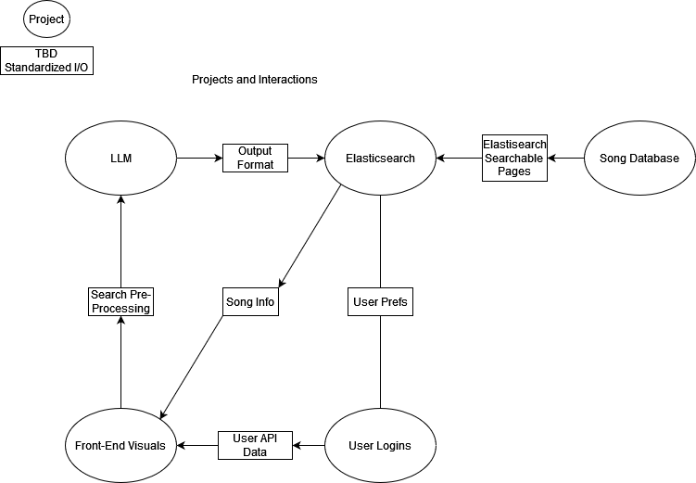
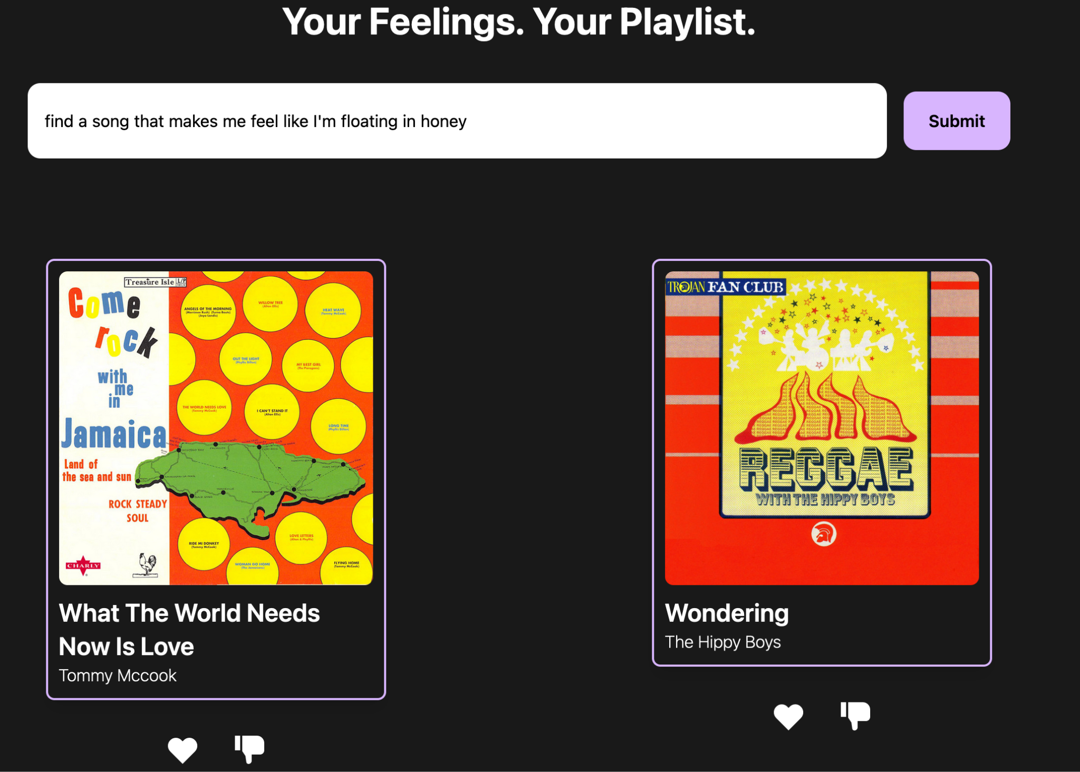
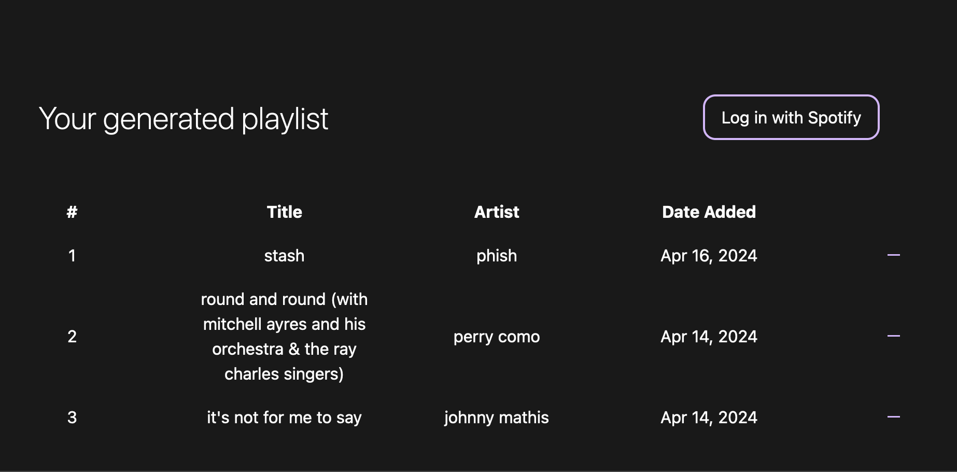
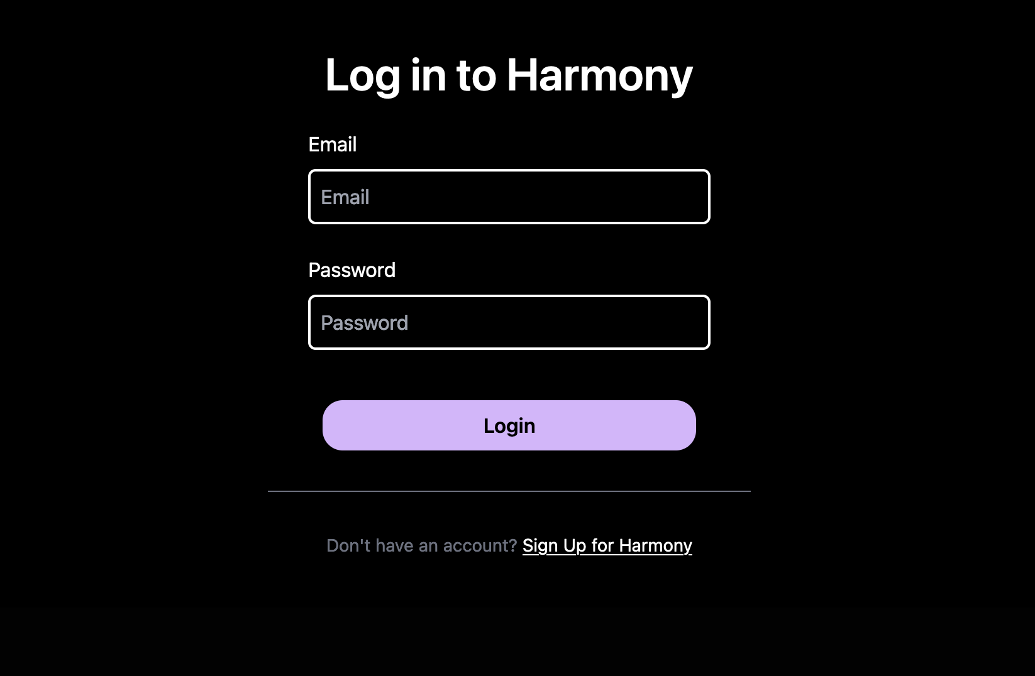
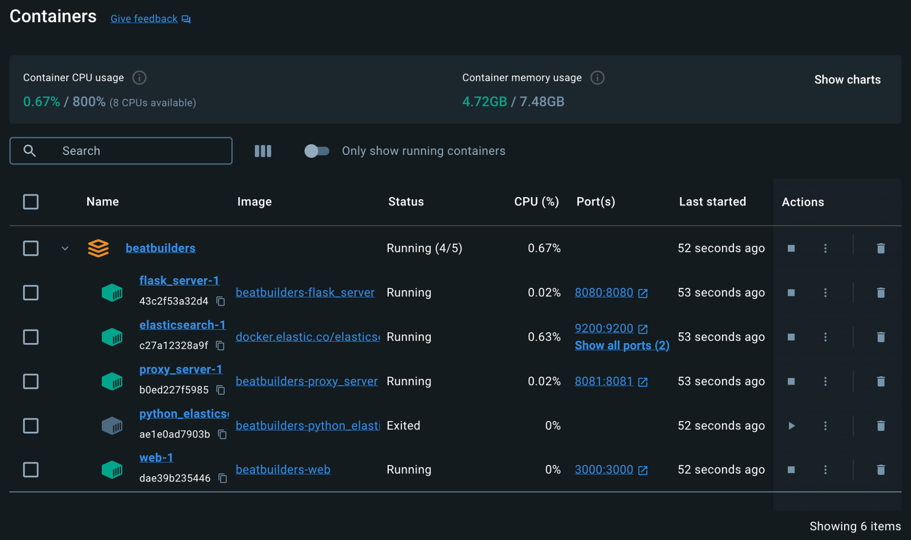
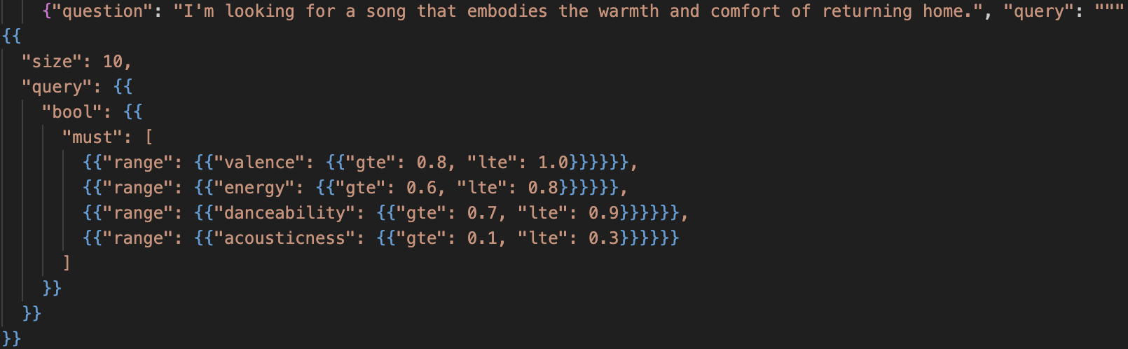
Beat Builders
Your Feelings, Your Playlist
A Natural Language, Sentiment Analysis Playlist Creator
Decision Making and Planning
Members of our team wanted an application that would help capture abstract moods and feelings in their music playlists. Spotify has premade playlists for various moods and feelings, but that is not interactive and assumes users have the precise words to describe what they are looking for. That’s where Beat Builders, an LLM powered playlist generator comes in.
Large Language Model
The team split up into 5 different teams to simplify the scope of each member’s contribution. To do this, we decided on the 5 groups listed below and agreed on what information might need to be passed from one team to another. This allowed us to standardize our interteam I/O and stay focused on one project at a time, while hopefully making integration easier in the future.
Our application utilizes Gemini 1.0 Pro to convert free-form user input into a query on our elasticsearch database.
We used the LangChain library to give Gemini 1.0 some information about our database layout and to perform few-shot prompting.
Gemini’s reasoning ability makes it very easy to parse free-form input and perform sentiment analysis. This makes it very intuitive and nearly cathartic to interact with our recommendation system.
However, because the user interfaces almost directly with a pre-trained LLM, it means our app is open to the unpredictability of
Main Page
User Generated Playlist
Authentication and Spotify Integration
The Spotify API was used in several different ways in our project. On a base level without signing into Spotify with our application, the Spotify API generates an access token when the page first loads to be used for song information.
Then, when a user submits a request and the song titles are returned from the database, the Spotify API is queried with the song title and artist and returns a large JSON of all songs that it finds.
From that, our program takes the best matching result from that and creates a Track object with the song’s title, artist, URL to its cover art, URL to its 30 second preview, and the ID from Spotify. Then the Tracks are converted to SongCards which are displayed on the main page.
Also, if the Spotify API does not have a song preview URL for the song, the program uses the Deezer API and pulls a preview link for it.
Once you have created your desired playlist you are able to login to Spotify and link your account with our application. Then, a new access token with elevated privileges is generated and it is able to add your playlist to your personal Spotify account.
Login Screen
Docker Containers
Elasticsearch
Elasticsearch is a document-based search engine that utilizes structured queries to retrieve information from various files. Our application uses it as a tool to query a database made of more than 28,000 songs.
An Elasticsearch model is first created by defining an index. The BeatBuilders application makes use of the Pandas Python library to first build a dataframe from a CSV file of songs and their information and then define an index with the “_index” format for Elasticsearch. This process transfers CSV information to a JSON format that is ready to be queried.
Our database contains more than 20 numerical in addition to the normal identifying information of each song. Our team built different example RANGE queries for Elasticsearch to search based on these numerical attributes. This allows user input to be fully open-ended and easily adapted to a query format. An example of a RANGE Elasticsearch query can be seen below:
Front End
Our goal with the frontend was develop an intuitive and interactive user interface. The design for the website was originally conceived in a Figma mock-up. It takes inspiration from Spotify’s design. The user first interacts with the sign up screen. They can then create an account, after which they will be navigated to the main page. If they already have an account, they can sign in. Both the sign-up and login pages have field validations, which check if the user has left a field empty or not met field requirements. Errors are clearly displayed for the user to correct.
Once on the main page, users interact with a search bar where they can input the mood or feeling they want songs to capture. After hitting the enter key or clicking the submit button, a loading circle signals to the user that our recommendation system is at work. When the recommendation system has finished collecting songs, users will see two song cards. They can either press the heart button to like the song, or the dislike button to dislike the song. If they like dislike a song, another song will be presented to them. If they like the song, the song information will automatically populated in the Your Generated Playlist table.
Arjun Thomas, Jason Burghart, Nick Ospelt, Ross Imbrock, Toby McGuire, Tom Nemeck, Tyler Jachimski, Vishal Kumar

